Slide 1
Distributed Convex Optimization Framework based on Bulk Synchronous Parallel (BSP) model
Presenter: Behroz Sikander
Supervisor: Prof. Dr. Hans-Arno Jacobsen
Advisor: Dipl.-Ing. Jose Adan Rivera Acevedo
Date: 4th March, 2016

Slide 2
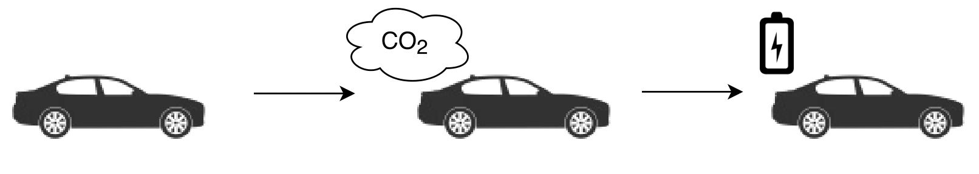
Trend towards electric vehicles
Notes:
- Governments are trying to reduce carbon emission
- EVs play an important role in this strategy

Slide 3
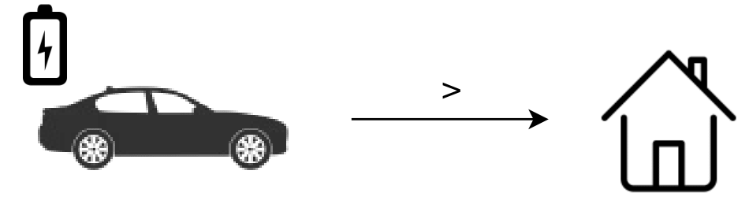
Trend towards electric vehicles
Electric vehicles takes more power than a house

Slide 4
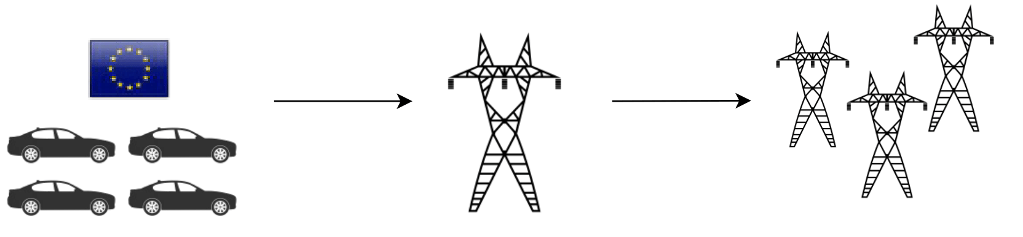
Trend towards electric vehicles
Electric vehicles takes more power than a house
9 Mio EVs -> Grid overloaded! Increase Infrastructure.

Slide 5
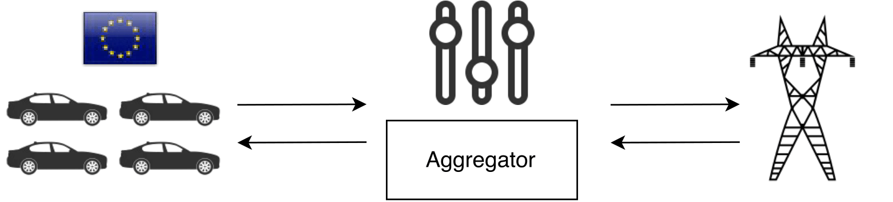
Keep infrastructure. Controlled EV charging
Notes:
1- Aggregator is a central party and takes care of the goals from grid and Evs
2- It keeps a balance between the two
3- Controlled charging can also help in feeding energy back to grid
4- This approach is proposed by my advisor
5- Aggregator acts as an interface between grid and EV fleet
6- Balance can be achieved by solving a large distributed optimization problem.
8-

Slide 6
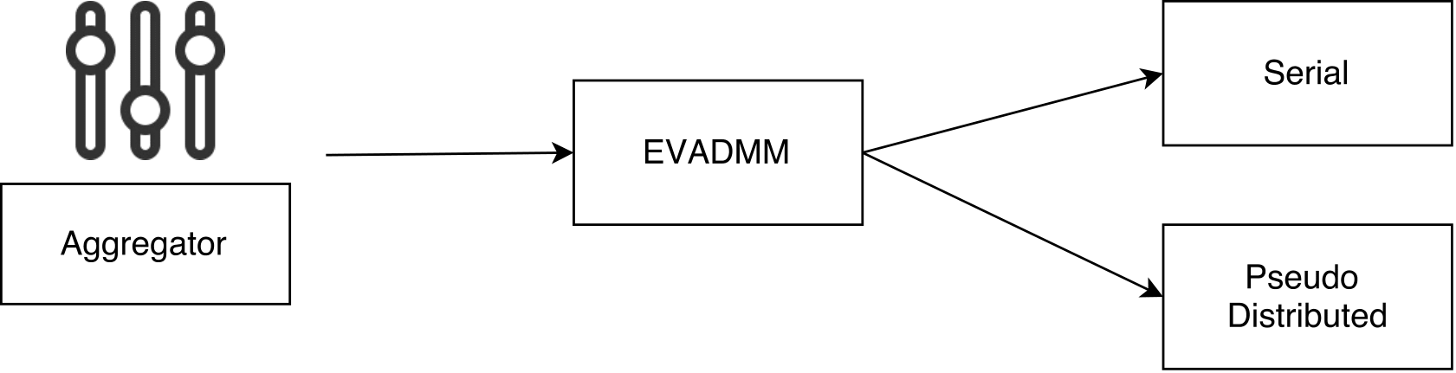
Keep infrastructure. Controlled EV charging
Proposed solution -> EVADMM

Slide 7
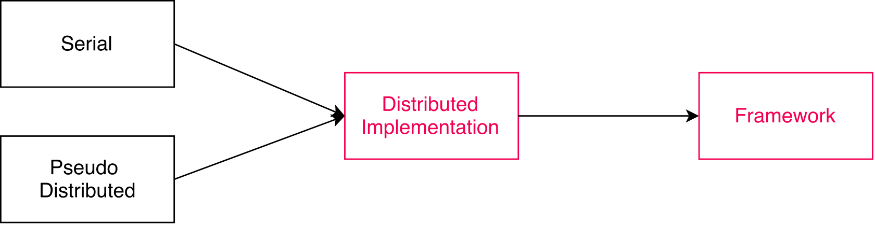
Keep infrastructure. Controlled EV charging
Proposed solution -> EVADMM
Thesis Goal: Distributed implementation & Framework

Slide 8
Total time to process N EVs using M machines ?
Total machines required to process N EVs in T time ?
Notes:
1- We also want to answer the questions like
2- Resources are limited but can we go beyond that ..
3- Can we create a model that explains our current results and can also explain the behavior when we go beyond our limits in our cluster ?
4- Using this model we can predict and it can give us useful insights if somebody is trying to use this in future.

Slide 9
Agenda
Background
Algorithm
Deployment
Results
Framework

Slide 10
Background

Slide 11
BSP
Bulk Synchronous Parallel
Developed by Leslie Valiant in 1980s
Model for designing parallel algorithm
Strong theoretical background
BSP computer has
    p processors
    each with local memory
    point-point communication

Slide 12
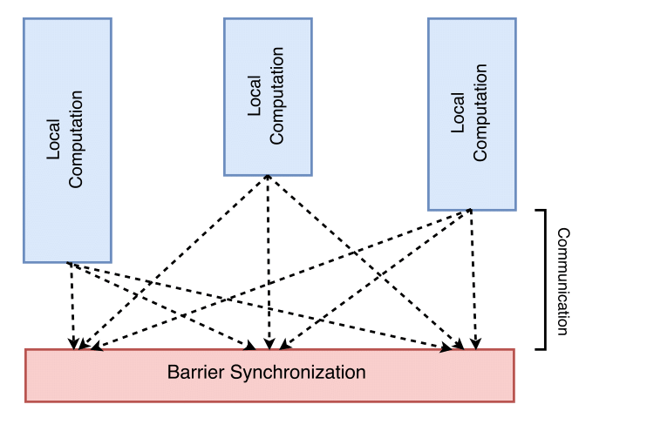
Supersteps
. . .
Computation divided in supersteps
    concurrent local computation (w)
    global communication (h)
    barrier synchronization (l)
. . .
Notes:
1- Just as in MapReduce, computation is divided into multiple Map/Reduce phases, the computation in BSP model is divided in multiple supersteps ….
2- -> Each process performs local computation
-> Then has the option to send some messages
-> Processes enters barrier synchronization mode, which means that that specific process has finished its local computation and communication. When all the processes enter the synchronization, next super steps starts

Slide 13
Supersteps
. . .
Computation divided in supersteps
    concurrent local computation (w)
    global communication (h)
    barrier synchronization (l)
Total runtime of all supersteps
    W + H.g + S.l
    where W is the total local comp. time
    g = time to deliver a message
    H.g = total time for communication
    S = total supersteps
    S.l = Total time required for barrier synchronization
. . .
Notes:
Since, BSP is based on strong theoratical backgrounds, we can find the total runtime of parallel algorithm.

Slide 14
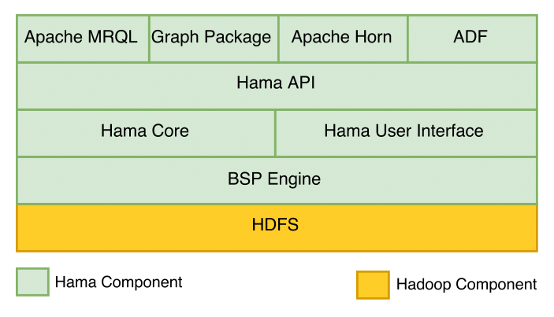
Apache Hama
Opensource, in-memory and iterative
Distributed computation framework
BSP programming model
Processes data stored in HDFS
Replacement of MapReduce
Can process massive datasets
Clean programming interface

Slide 15
HDFS
Distributed storage
Runs on commodity hardware
Master-Slave model (Namenode and DataNode)
Files are broken down into blocks of 128MB.
Can store huge amounts of data
Scalable, available and fault tolerant
This thesis : Used to store data

Slide 16
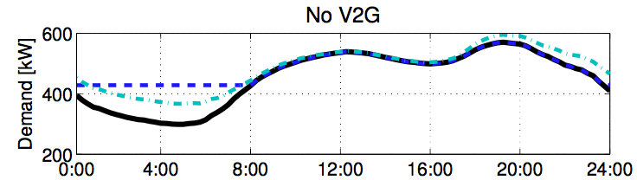
Algorithm
Controlled charging has to strike a balance between
Grid goals (Valley Filling)
    EV charging in valleys of fixed demand
    Avoid peaks
    Leads to stable system
EV goals (EV Optimization problem)
    Minimize battery depreciation
Notes:
Controlled Charging has 2 parties GRID/EVs.

Slide 17
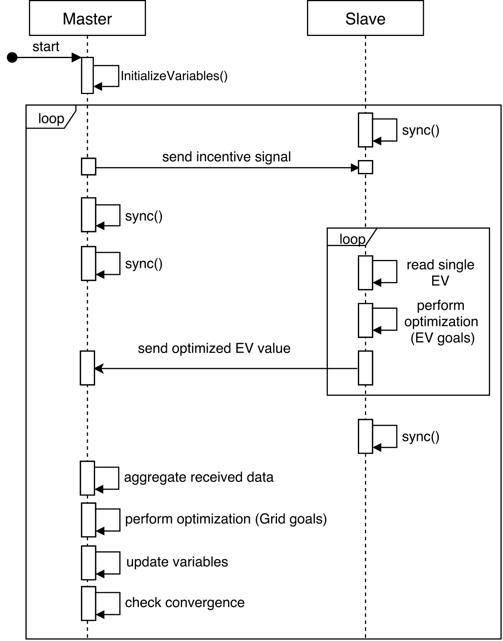
Algorithm
Master executes Grid goals
Slave executes EV goals
sync used for barrier synchronization
1 Master, N Slave tasks

Slide 18
Deployment

Slide 19
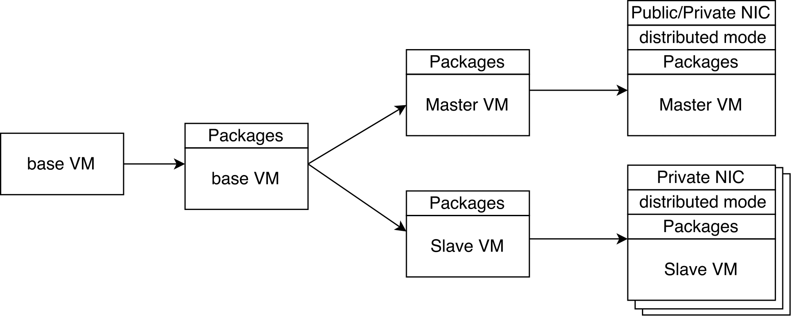
LRZ
Leibnitz RechenZentrum
Infrastructure as a Service
Flexible, secure, highly available
Used 10 VMs (Ubuntu, 4 CPU, 8GB RAM)
Installed Hadoop, Hama and CPLEX in distributed mode
Notes:
Explain Public/Private NIC

Slide 20
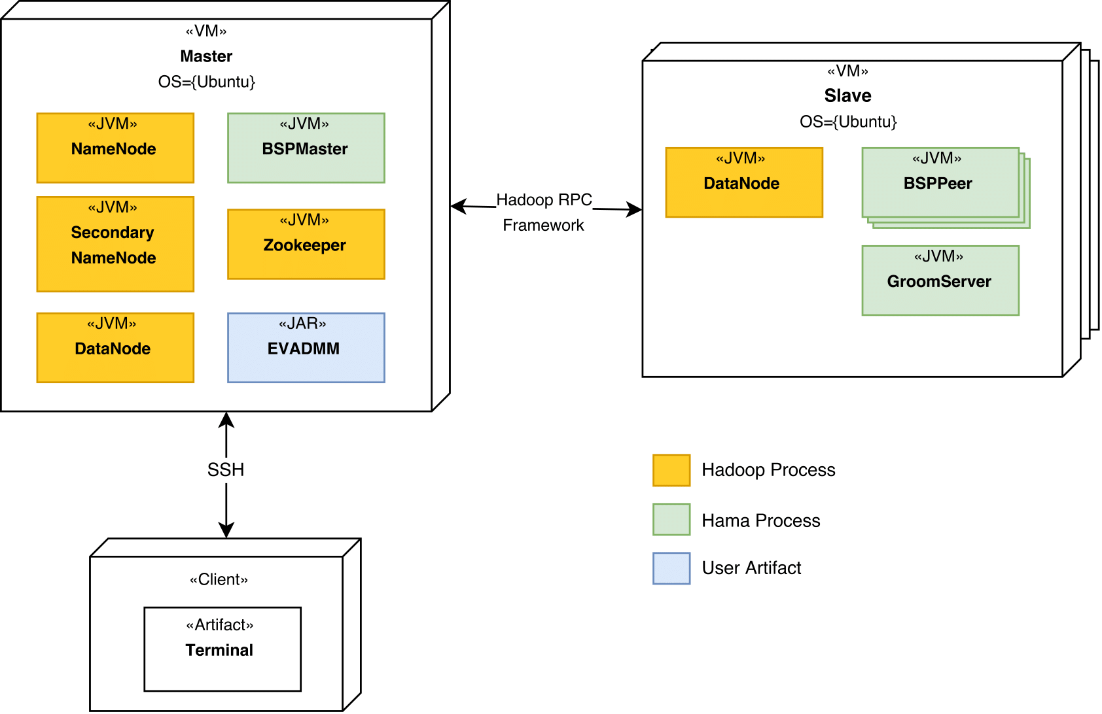
Deployment
Client submits the job to BSPMaster
BSPMaster communicates with GroomServer to start multiple BSPPeer (tasks).
Each slave can run upto 5-6 tasks in parallel.
Example: 9 slaves will have 54 tasks running in parallel executing the submitted job.
Notes:
1- Client submits job to BSPMaster
2- BSPMaster communicates with GroomServer on Slaves
3- GroomServer opens up multiple BSPPeers
4- Actual code is executed on BSPPeers

Slide 21
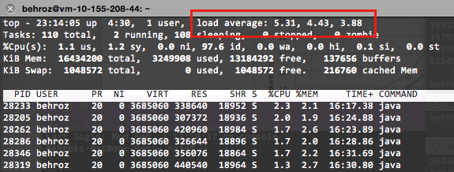
Deployment
Client submits the job to BSPMaster
BSPMaster communicates with GroomServer to start multiple BSPPeer (tasks).
Each slave can run upto 5-6 tasks in parallel.
Example: 9 slaves will have 54 tasks running in parallel executing the submitted job.
Notes:
1- Client submits job to BSPMaster
2- BSPMaster communicates with GroomServer on Slaves
3- GroomServer opens up multiple BSPPeers
4- Actual code is executed on BSPPeers

Slide 22
Results

Slide 23
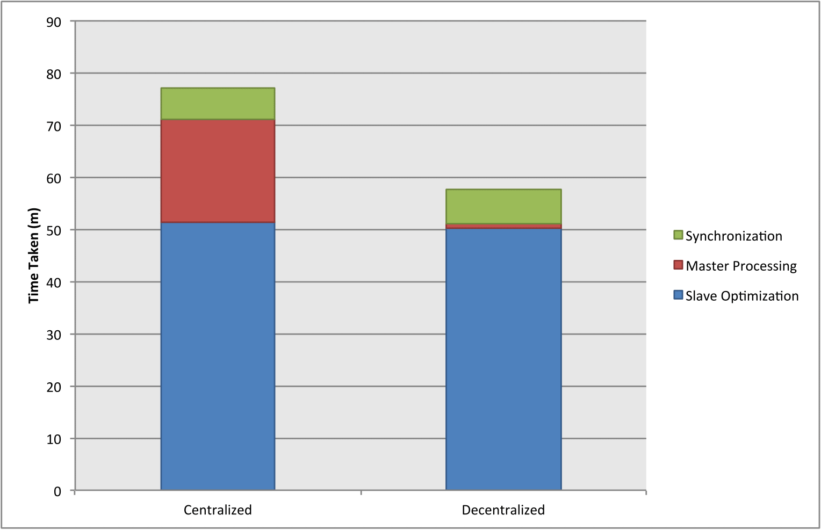
Runtime behavior
Time taken while processing 100K EVs for 400 supersteps using 50 tasks.
    65% spent on EV optimization (W_{s})
    25% spent on Master processing (W_{m})
    10% spent on synchronization (S.l_{s})
W_{s} can be decreased by adding more computation power.
Problem: Processing on Master is a bottleneck.
Solution: Decentralized Approach
S.l_{s}
W_{m}
W_{s}
Notes:
As mentioned previously, that calculating the total runtime for BSP based algorithm is possible.
For this specific algorithm, the total runtime is equal to T_total …..
During runtime, we measure all the parameters mentioned in this equation
When Master is processing, all the Slaves are in waiting state. So, more time Master waits , more time our algorithm takes

Slide 24
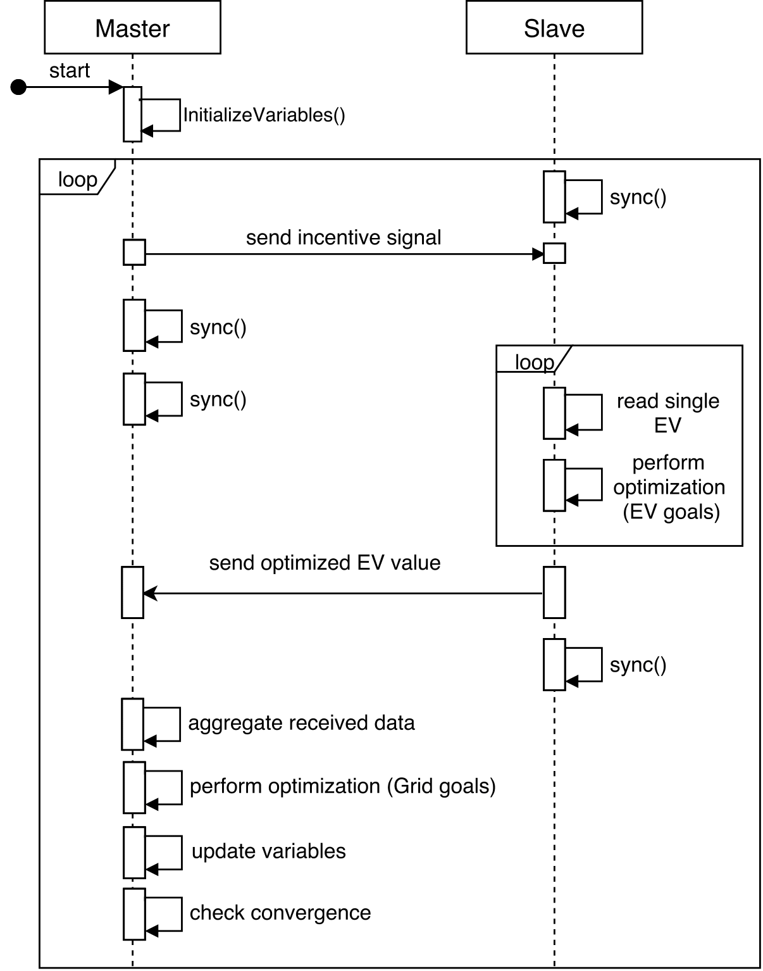
Algorithm
Measured the time taken by different operations on Master
Updated algorithm sends aggregated values only
Notes:
1- Inner for loop is executed on multiple Slaves 1…N
2- Only 1 master and everything else is computed on it.

Slide 25

Decentralized Approach
Total time reduced to 58 minutes from 78.
    89% spent on EV optimization (W_{s})
    1% spent on Master processing (W_{m})
    10% spent on synchronization (S.l_{s})
Notes:
Since master processing has very small impact. It can be removed from total time consideration.

Slide 26
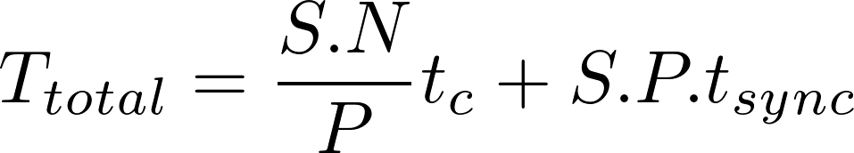
Runtime model
Can be reformulated in terms of total supersteps (S), total parallel process (P) and total EVs (N)
    t_{c} represents the time taken to solve a single EV optimization problem. Average value 6.5 ms.
    t_{sync} average time slave spends waiting for barrier synchronization. Average value 57 ms.

Slide 27

Total time to process 1 Mio EVs (N) in 200 supersteps (S) using 100 parallel processes (P) ?
* Average estimated time

Slide 28
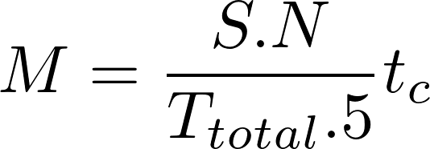

Total machines required to process 1 Mio EVs (N) in 100 supersteps (S) in 60 minutes (T) ?
* Assuming that each machine can run 5 Hama processes in parallel.

Slide 29
Framework

Slide 30
Framework (ADF)
ADMM Distributed Framework
For new algorithms, implementation needs to be started from scratch
Reusable set of classes
Automating the optimization process as much as possible

Slide 31
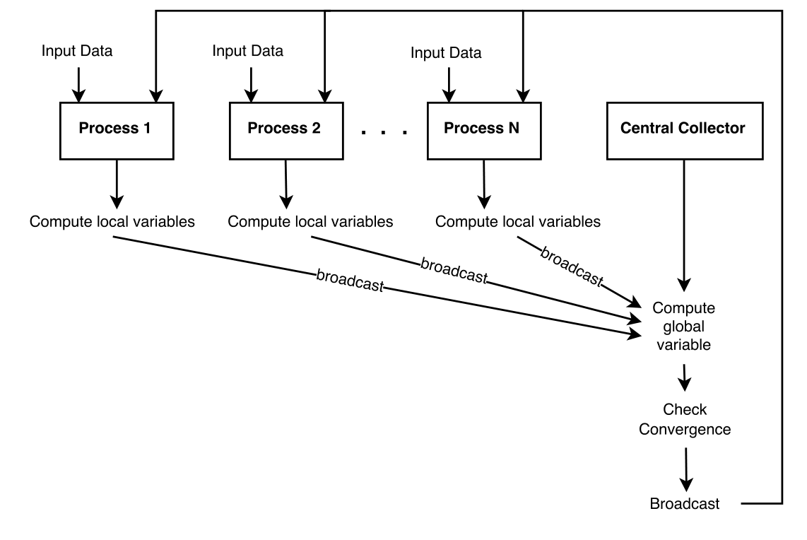
General Idea

Slide 32
Requirements
Solver agnostic
Modeling language
Supports multiple categories of ADMM problems
Functions
Abstraction on distributed system

Slide 33
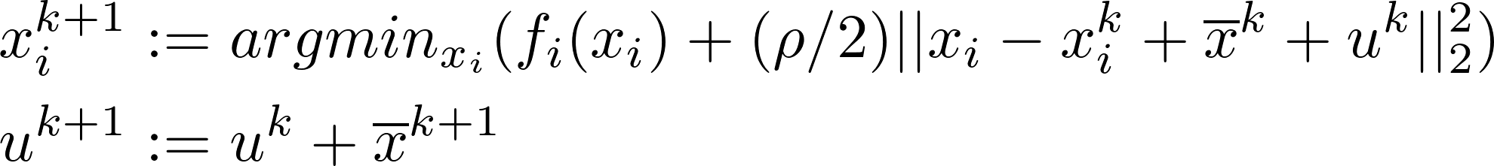
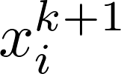
Solver & Modeling Language Agnostic
CPLEX, Gurobi, OPL, CPL
Exchange problem
All we care about is the value of
User can implement XUpdate interface using any solver or modeling language !

Slide 34
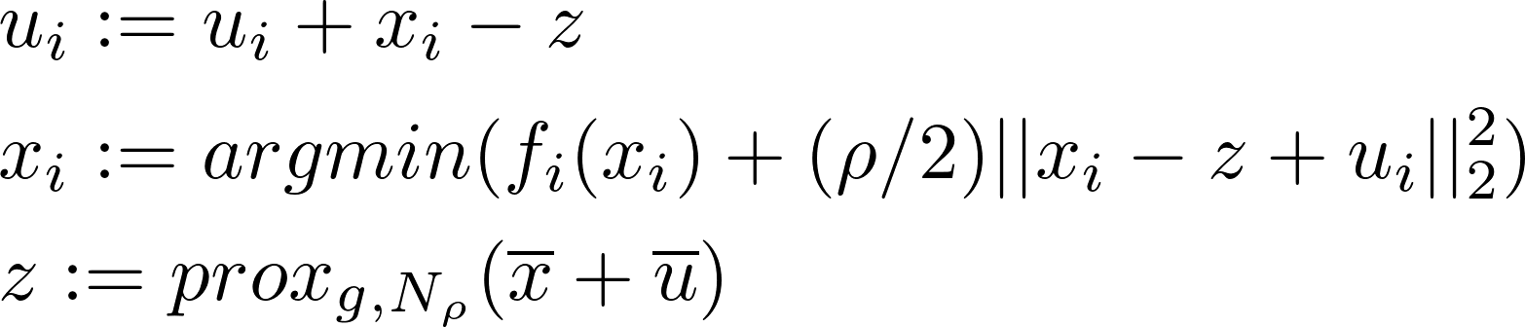
Multiple ADMM Categories
Exchange problem
Consensus problem
Extend BSPBase, ContextBase abstract classes
Notes:
ADMM can solve variety of problems and 2 of them are mentioned here

Slide 35
Functions
Exchange problem
Implement XUpdate interface for new functions and provide them at startup

Slide 36
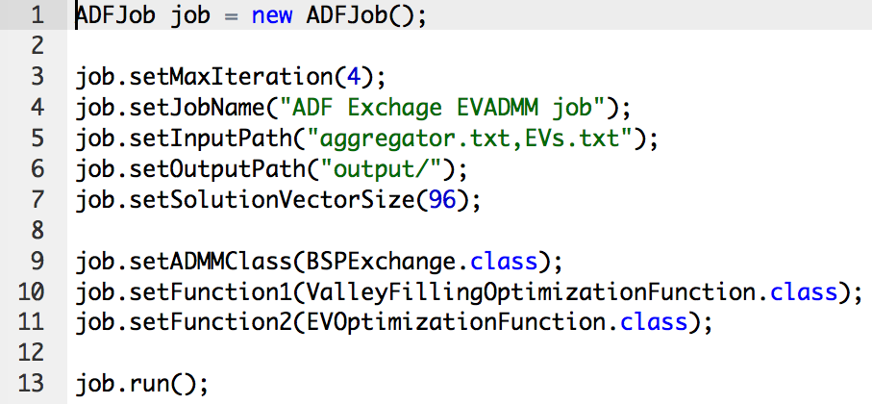
Abstraction on distributed system

Slide 37
Conclusion

Slide 38
Conclusion
Reproduce EVADMM on distributed environment
    Data aggregation on slaves massively decreases the total runtime. Parallelize time consuming serial parts of algorithm.
Foundation for a general framework to solve similar problems
Spark vs Hama -> Go with Spark
    Performance is equal
    Hama has very small community
    Even better -> Use Apache Beam/Google DataFlow

Slide 39
Conclusion
Reproduce EVADMM on distributed environment
    Data aggregation on slaves massively decreases the total runtime. Parallelize time consuming serial parts of algorithm.
Foundation for a general framework to solve similar problems
Spark vs Hama -> Go with Spark
    Performance is equal
    Hama has very small community
    Even better -> Use Apache Beam/Google DataFlow
Contributed to Apache Hama to add round-robin based task allocation.

Slide 40
Thanks!
Any questions?
You can find me at:
behroz.sikander@tum.de

Slide 41
References
S. Boyd, N. Parikh, E. Chu, B. Peleato, and J. Eckstein. “Distributed opti- mization and statistical learning via the alternating direction method of multipliers.”
S. Boyd and L. Vandenberghe. “Convex programming.”
J. Rivera, P. Wolfrum, S. Hirche, C. Goebel, and H.-A. Jacobsen. “Alternating direction method of multipliers for decentralized electric vehicle charging control.”
S. Seo, E. J. Yoon, J. Kim, S. Jin, J.-S. Kim, and S. Maeng. “Hama: An efficient matrix computation with the mapreduce framework.”
L. G. Valiant. “A bridging model for parallel computation.”

Slide 42
Backup Slides

Slide 43
Hama vs Spark
From usability perspective, Spark is better than Hama
    No need to understand the complications of distributed system
Hama provides better control on communication and synchronization than Spark
Hama is based on strong theoretical backgrounds whereas Spark is still evolving
Performance wise, both are more or less equal
    Recent paper shows that Hama is actually better when performing joins on big datasets
Further, ADMM is more natural to implement in BSP.

Slide 44
Lessons
Avoid loading data from file system -> In memory
Measure load on CPUs early. Overloaded CPU decreases performance
Parallel part should be very optimized and carefully implemented. -> Use profiling
3rd party -> Memory leaks

Slide 45
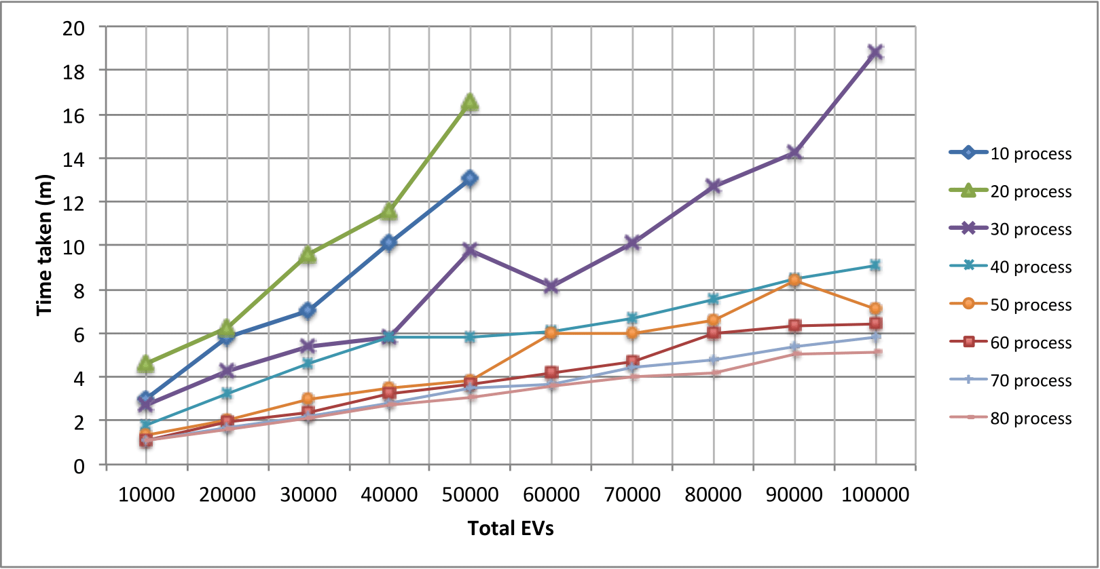
Synchronization Behavior
More data -> increase in synchronization time !
Reason: Irregular processing time of slaves
More processing power -> decreased synchronization time
~10-20% increase in sync. time for adding 10K EVs.

Slide 46
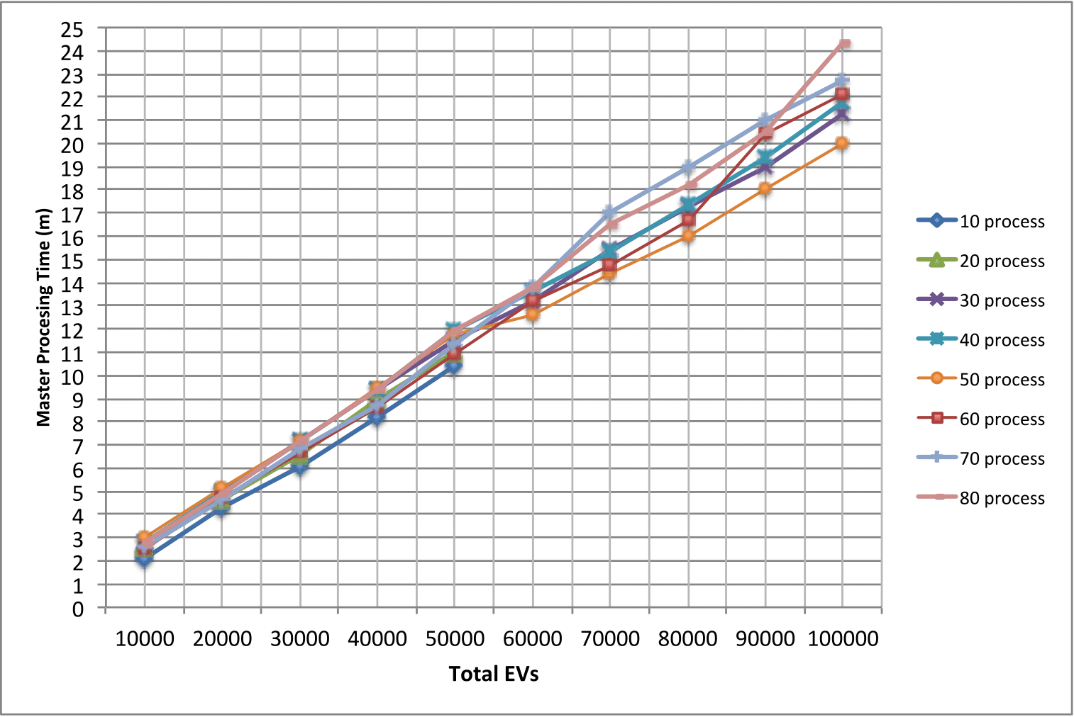
Centralized Master Processing Behavior
Time taken by master to process in 400 supersteps
    x-axis shows total EVs, y-axis shows time taken in minutes
    Each line represents a specific number of parallel tasks used
More data means to more time process
Increasing computation power has no effect. Reason: 1 master !
For 100,000 EVs in 400 supersteps it takes 25 minutes !!

Slide 47
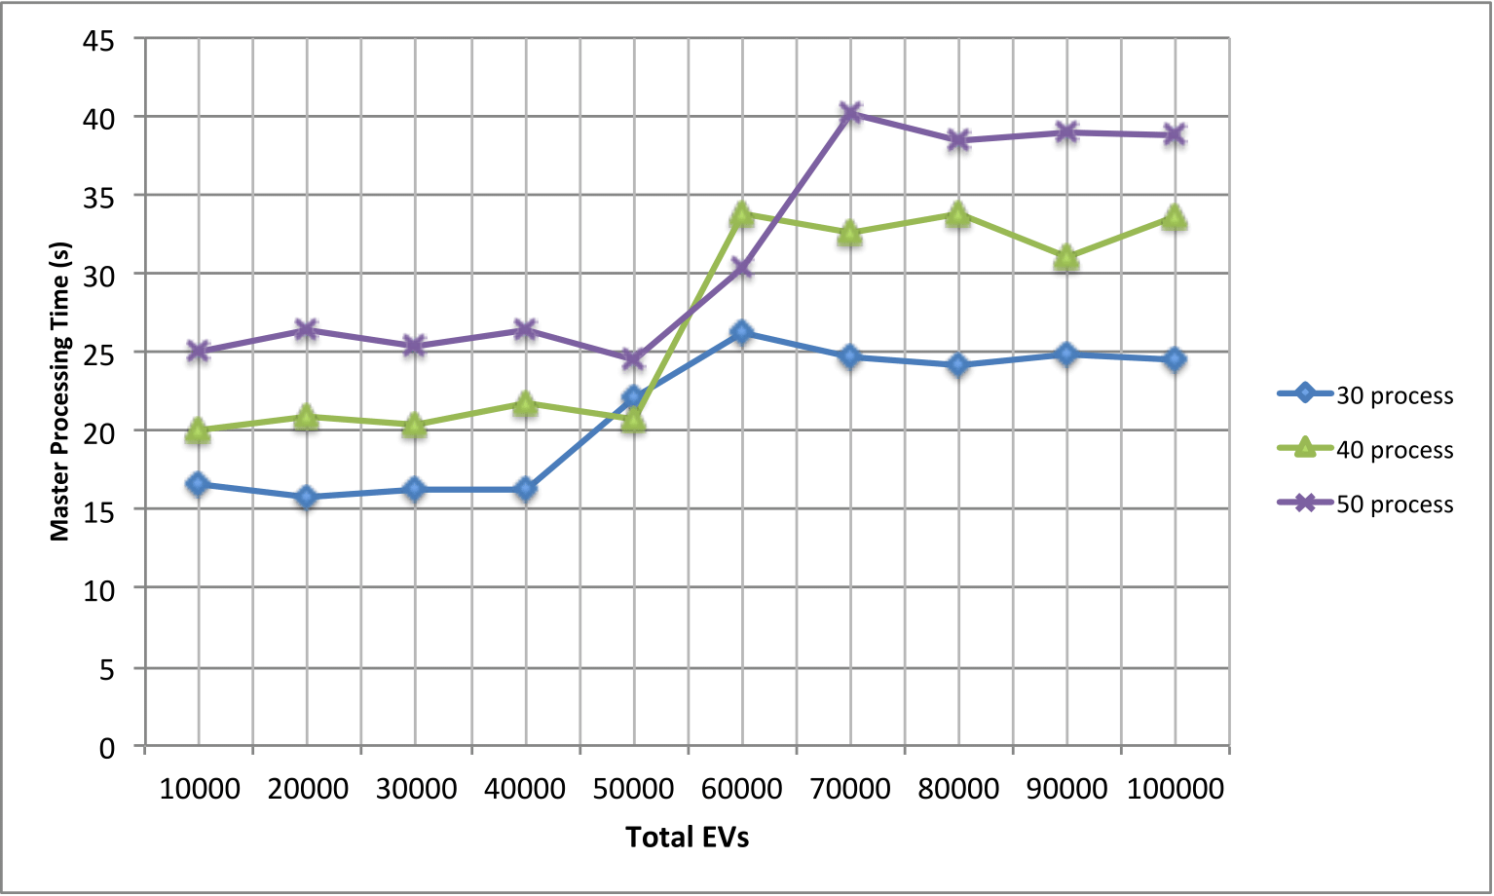
Decentralized Master Processing Behavior
Time taken by master to process in 400 supersteps
    x-axis shows total EVs, y-axis shows time taken in minutes
    Each line represents a specific number of parallel tasks used
No change while increasing data or processing power.
Reason: Number of incoming messages to process stays the same !
For 100,000 EVs in 400 supersteps it takes 40 seconds!!

Slide 48
Why not 1 Mio ?
Unreasonable time taken to process with current cluster

Slide 49
General Idea
Exchange problem
    x-update can be done independently (local variable)
    u-update needs to be computed globally because it depends on all x-updates. (global variable)
Consensus problem
    u and x update can be carried out independently
    z-update can only be computed globally

Slide 50
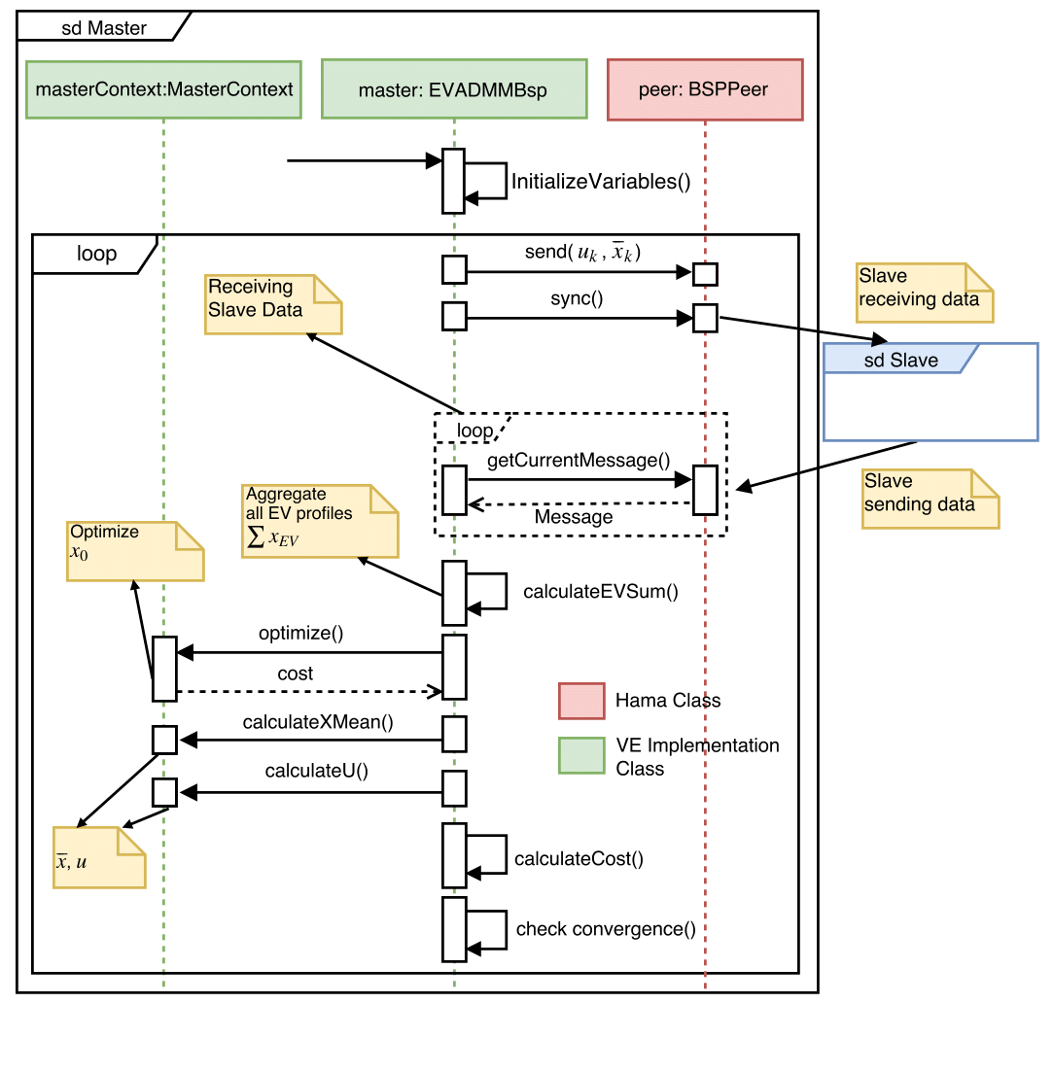
VE- Sequence Diagram

Slide 51
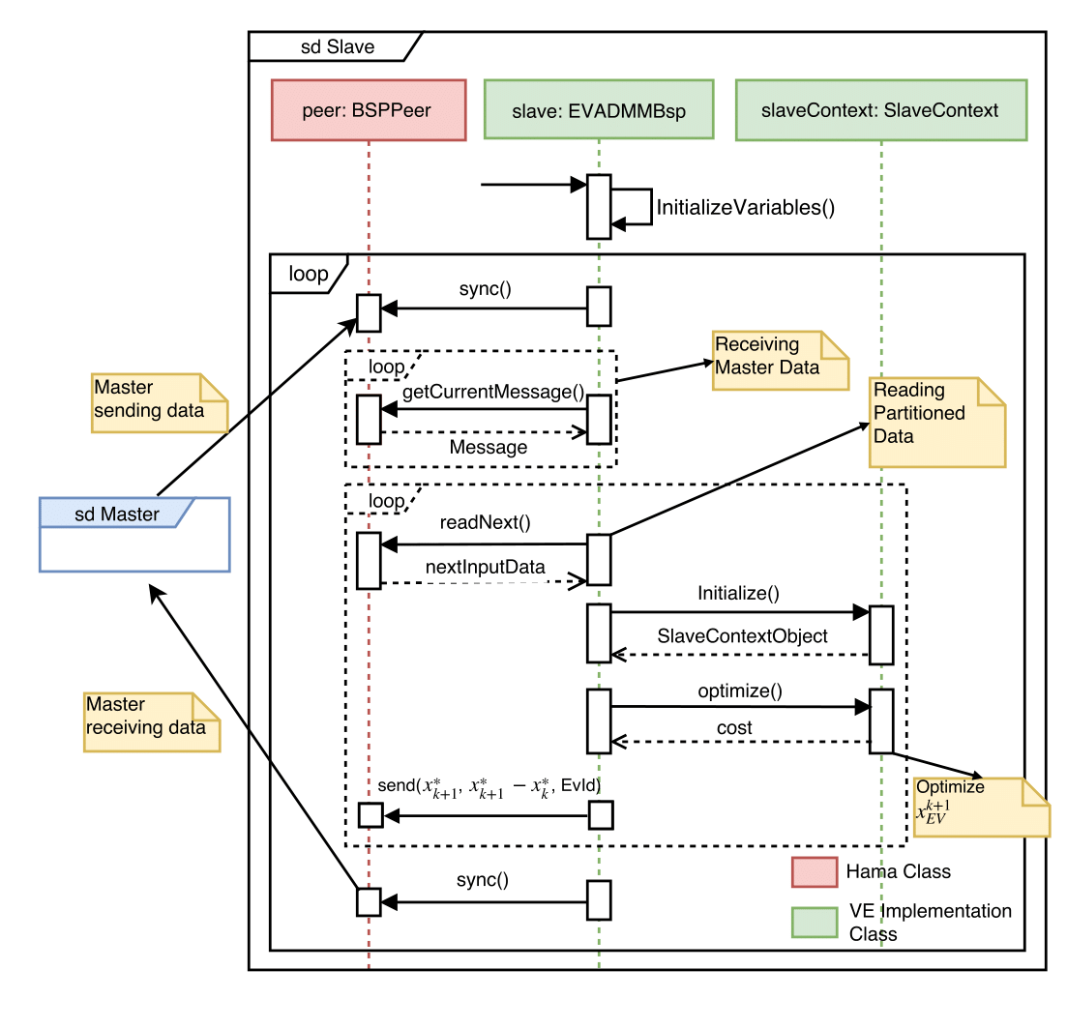
VE- Sequence Diagram

Slide 52
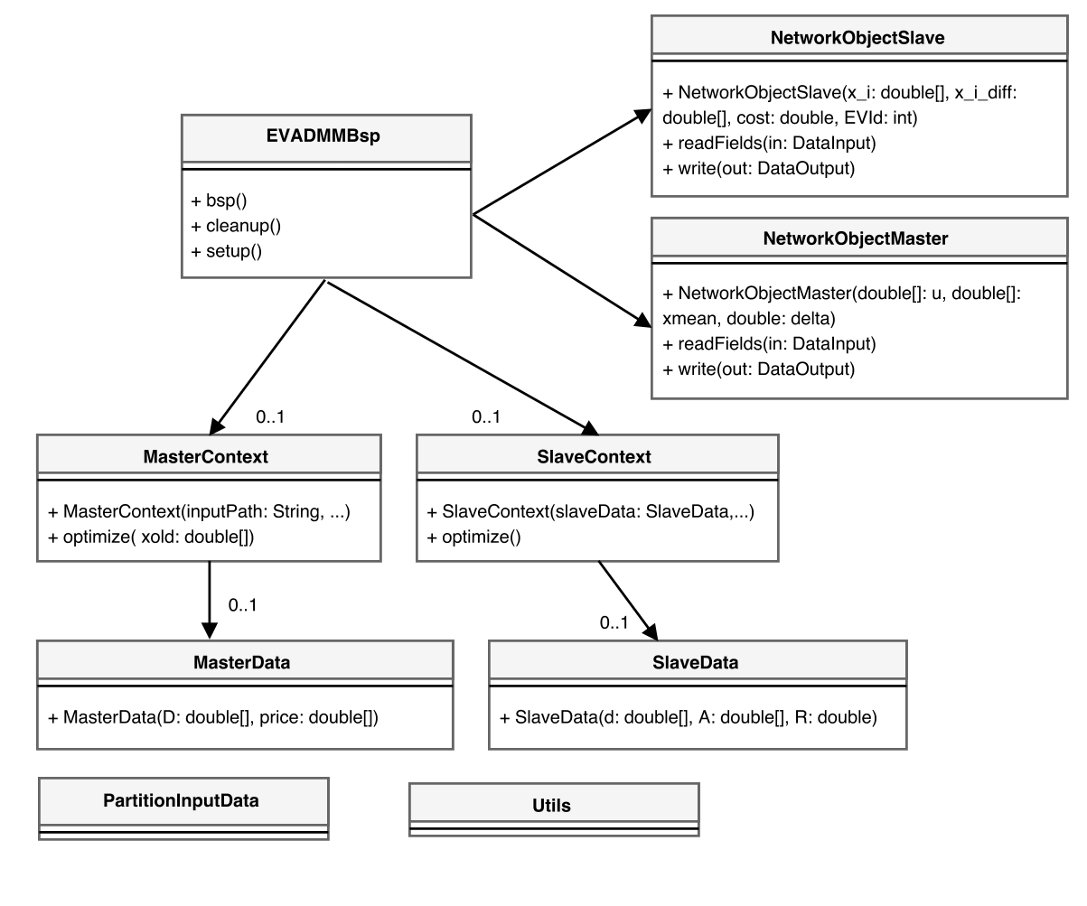
VE- Class Diagram

Slide 53
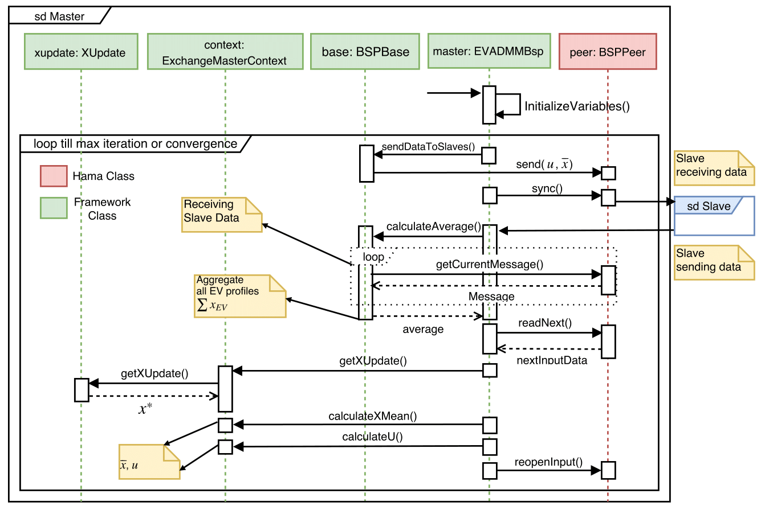
Framework- Sequence Diagram

Slide 54
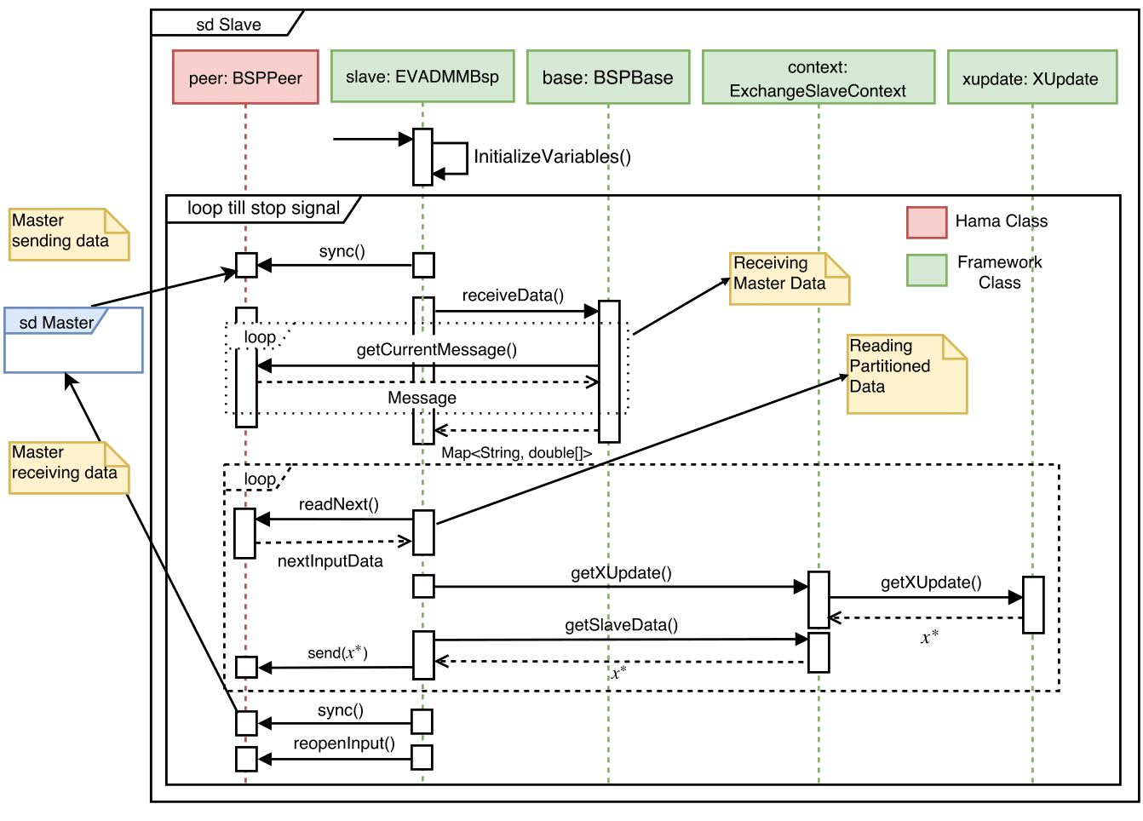
Framework- Sequence Diagram

Slide 55
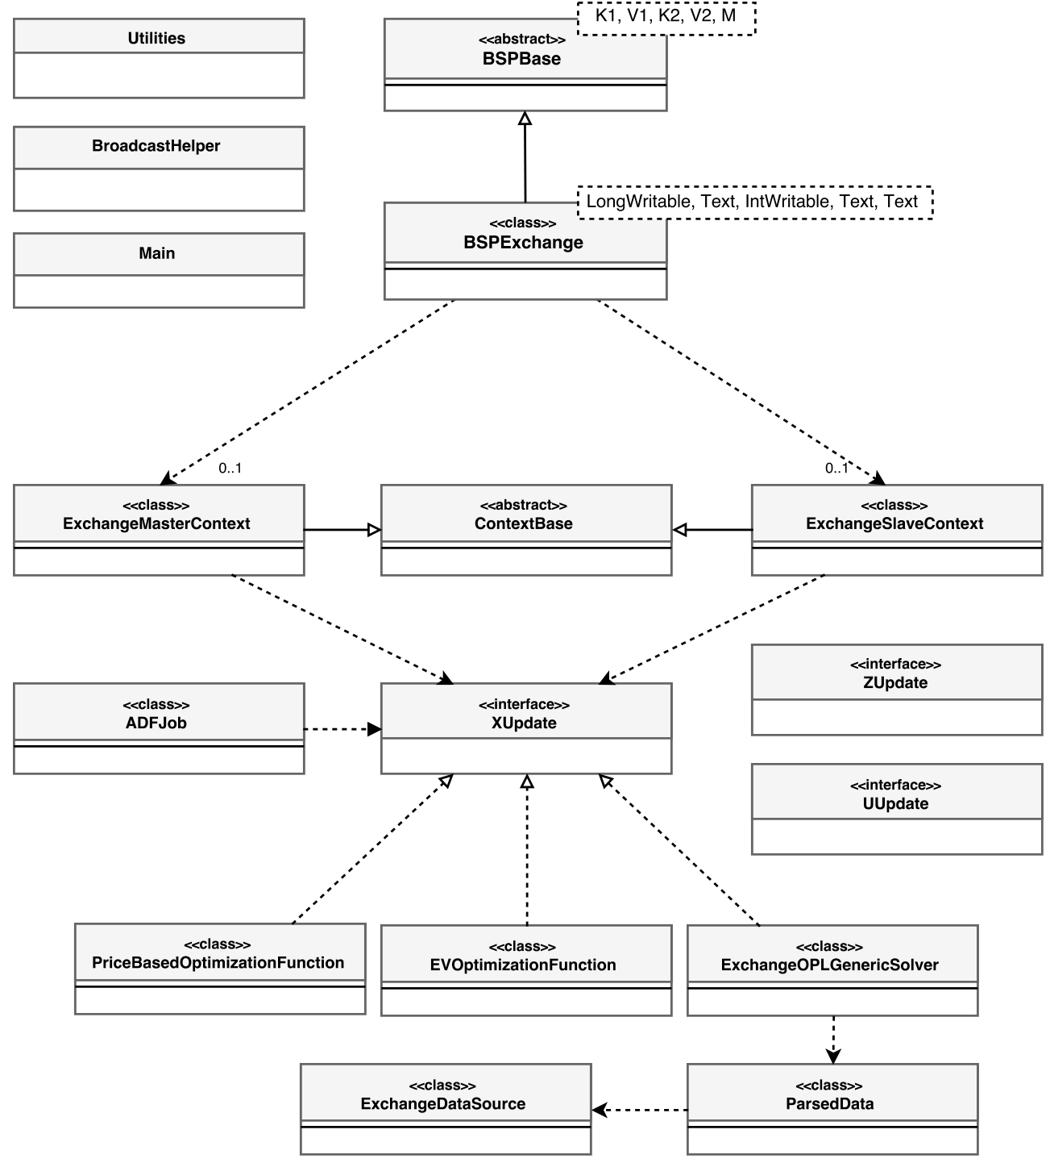
Framework- Class Diagram

Slide 56
Background

Slide 57
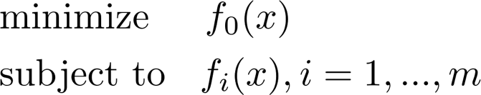
Optimization
Best solution from a set of alternatives
while being constrained by a criteria
Examples, portfolio optimization, device sizing

Slide 58
Convex Optimization
Objective and constraint functions as convex or concave
Solution guaranteed !

Slide 59
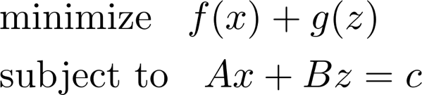
ADMM
Alternating Direction Method of Multipliers
Used for distributed convex optimization
Converts problems to local sub-problems
Use local solutions to find global solution
Iterative

Slide 60
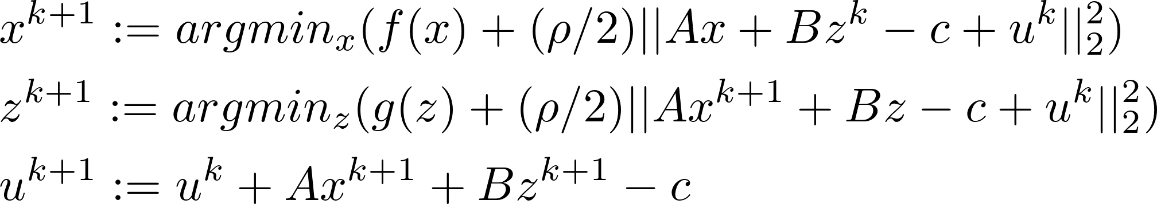
ADMM
Distributed ADMM form

Slide 61
Solvers
Software tools to solve mathematical problems.
Abstract out all the complexities
Simple programming interface
Cost functions and constraints can be modeled
Tools: CPLEX, Gurobi, SCIP, CLP, LP_SOLVE
This thesis : CPLEX

Slide 62
EVADMM
Increasing carbon emissions
Vehicles are a big source
Solution: Electric Vehicles (EV)
Charging an EV takes more power than a normal house
Solution: Increase infrastructure
Or controlled charging

Slide 63
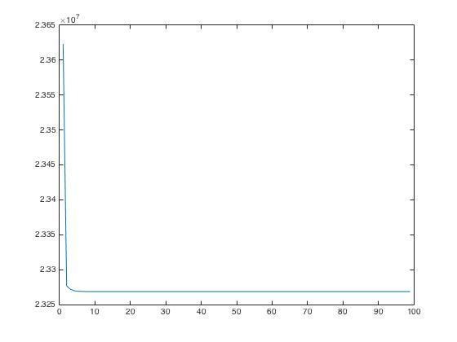
Convergence

Slide 64
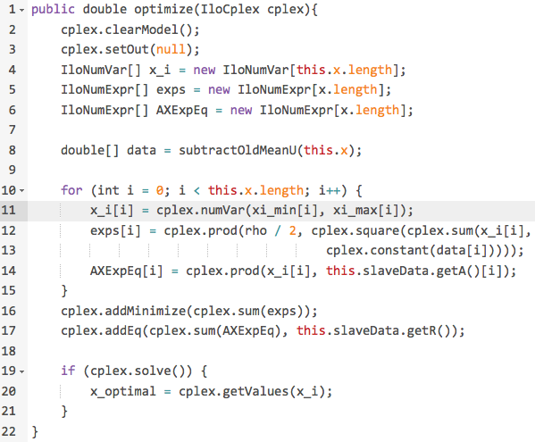
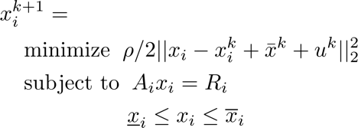
Solvers

Slide 65

Modeling Language
Specify equations more naturally
Internally convert to solver understandable format
Model + data file as input

Slide 66
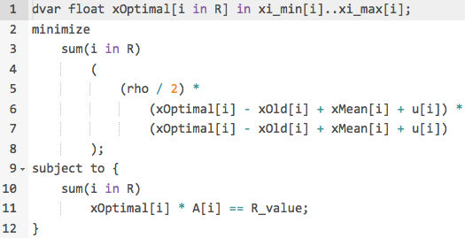
Modeling Language

Slide 67
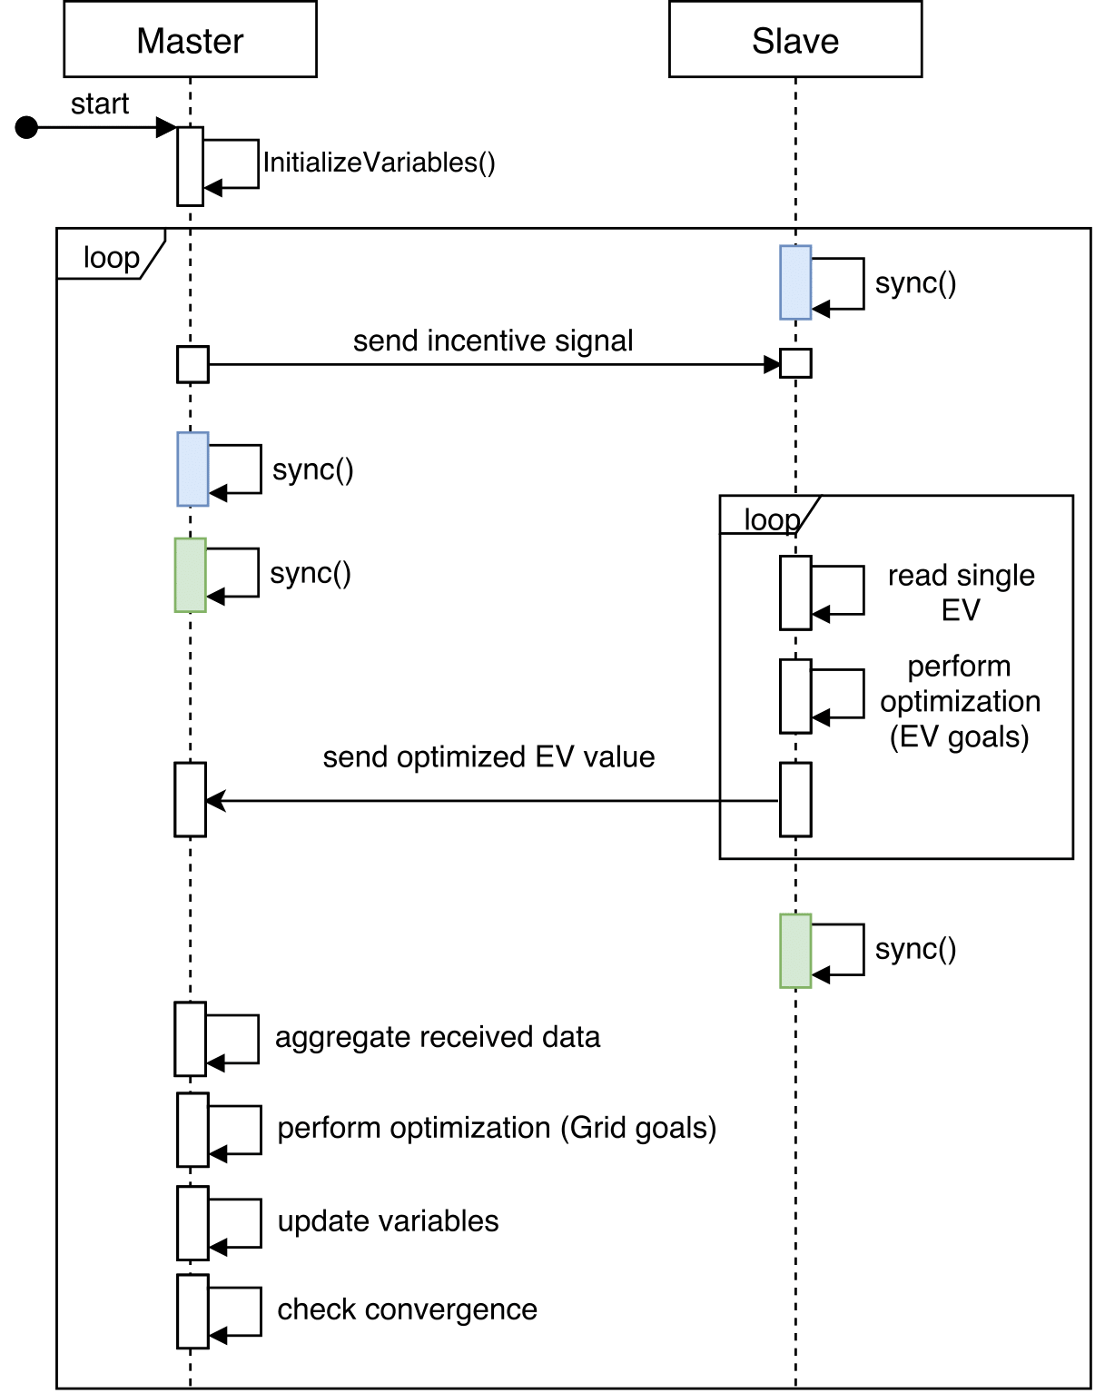
Algorithm
2 supersteps per iteration
To process 100K EVs, all Slaves will send 100K messages to Master

Slide 68
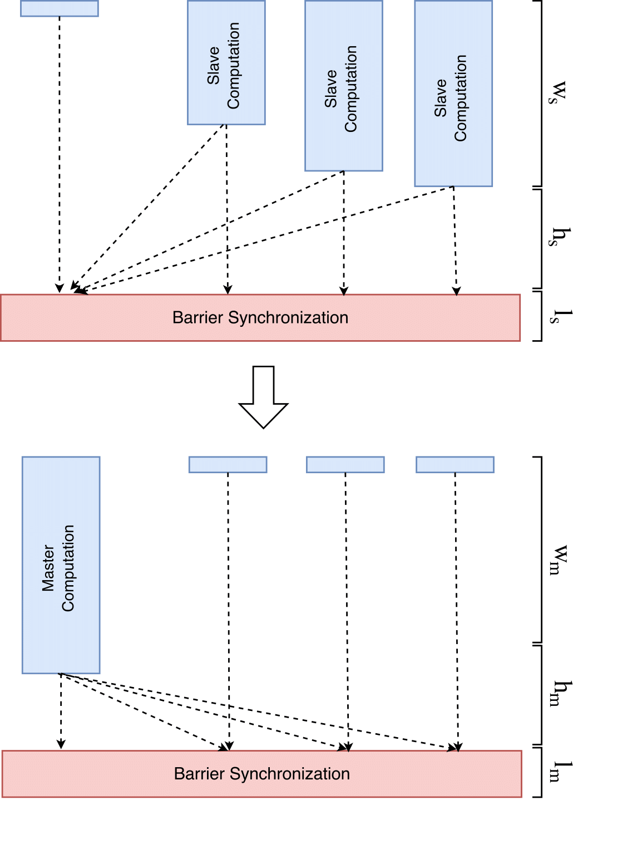
Supersteps
. . .
2 supersteps per iterations
    T_{total} = T_{slave} + T_{master}
Master/slave communication (h_{m}/h_{s}) and synchronization time (l_{m}) are insignificant
. . .

Slide 69
Deployment

Slide 70

Docker
light weight, secure, open source project
Package application and dependencies in Containers
Easily create, deploy and run containers
This thesis
    Deployment on compute server
    3 containers
    HDFS and Hama configured

Slide 71
Docker - Problems
/etc/hosts file read only
Dynamic Ips
No public IP
Single harddrive
No network latency

Slide 72
Problems- LRZ
Memory leaks
Processes randomly crashing
Firewall issues
Hama non-uniform process distribution

Slide 73
Top command

Slide 74
Related Work

Slide 75
Serial Implementation
Implemented in Matlab
Solver: CVXGEN
Data processed: 100 EV
Total processing time: 2 minutes

Slide 76
Distributed Implementation
Implemented in Matlab
parfor function of Parallel Computing Toolbox used
1 machine with 16 cores and 64 GB RAM
Data processed: 100,000
Solver: CVXGEN
Time: 100,000 EVs processed in 30 minutes

Slide 77
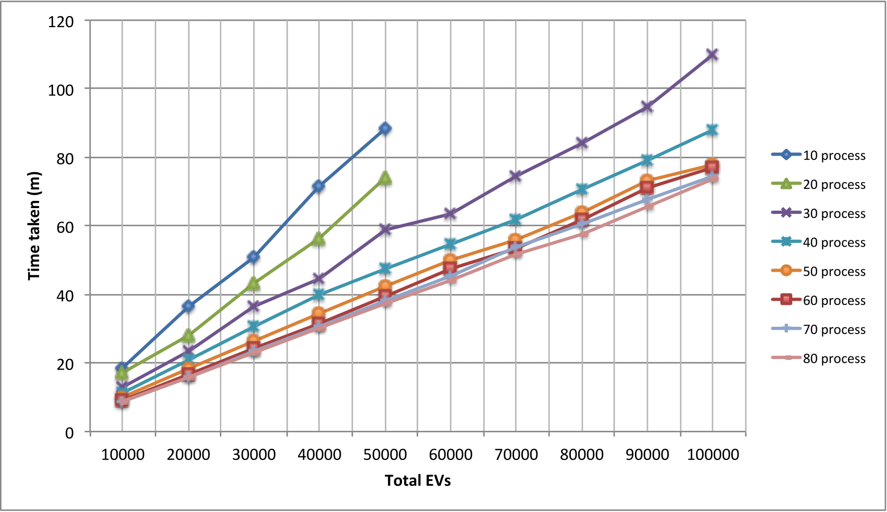
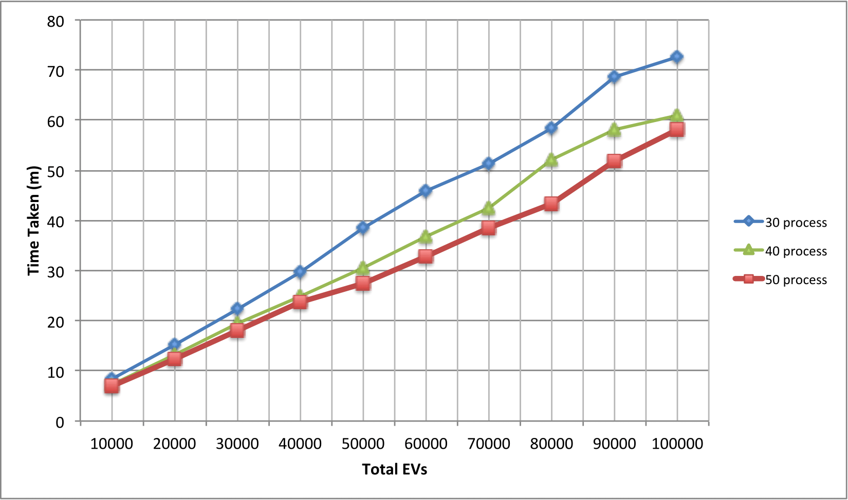
Overall runtime

Slide 78
Matlab vs Hama Implementation

Slide 79
Change at runtime ?

Slide 81
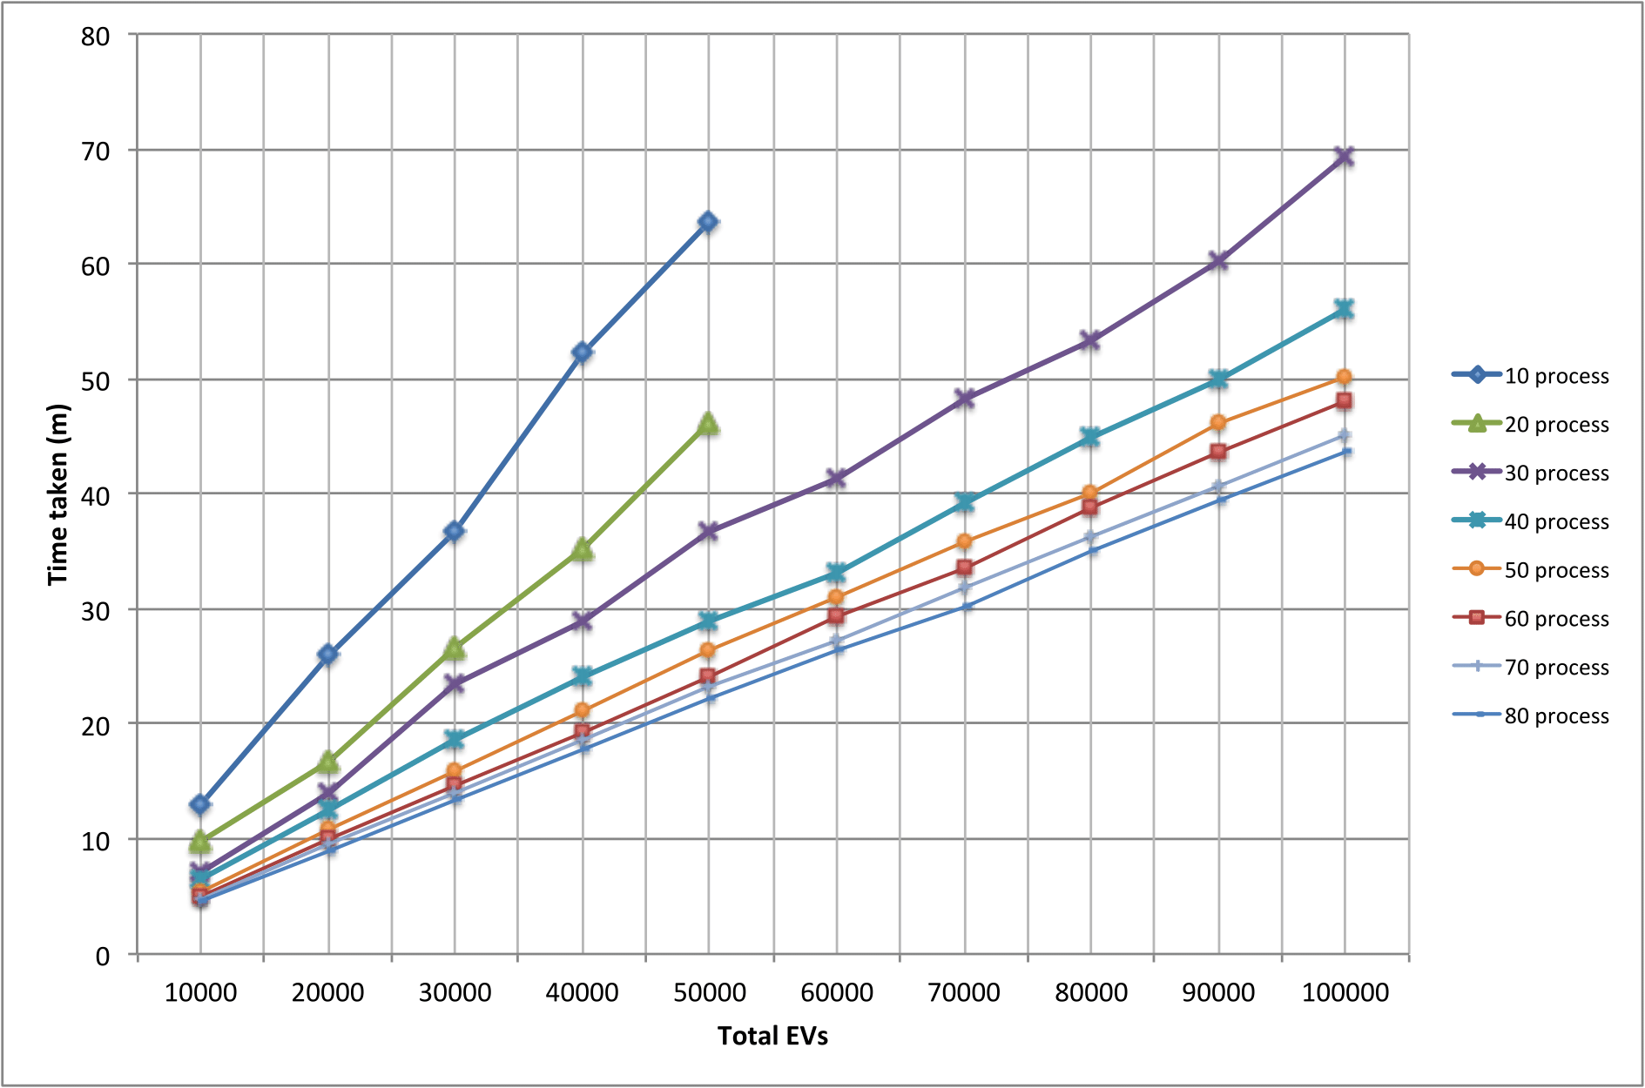

Slide 82
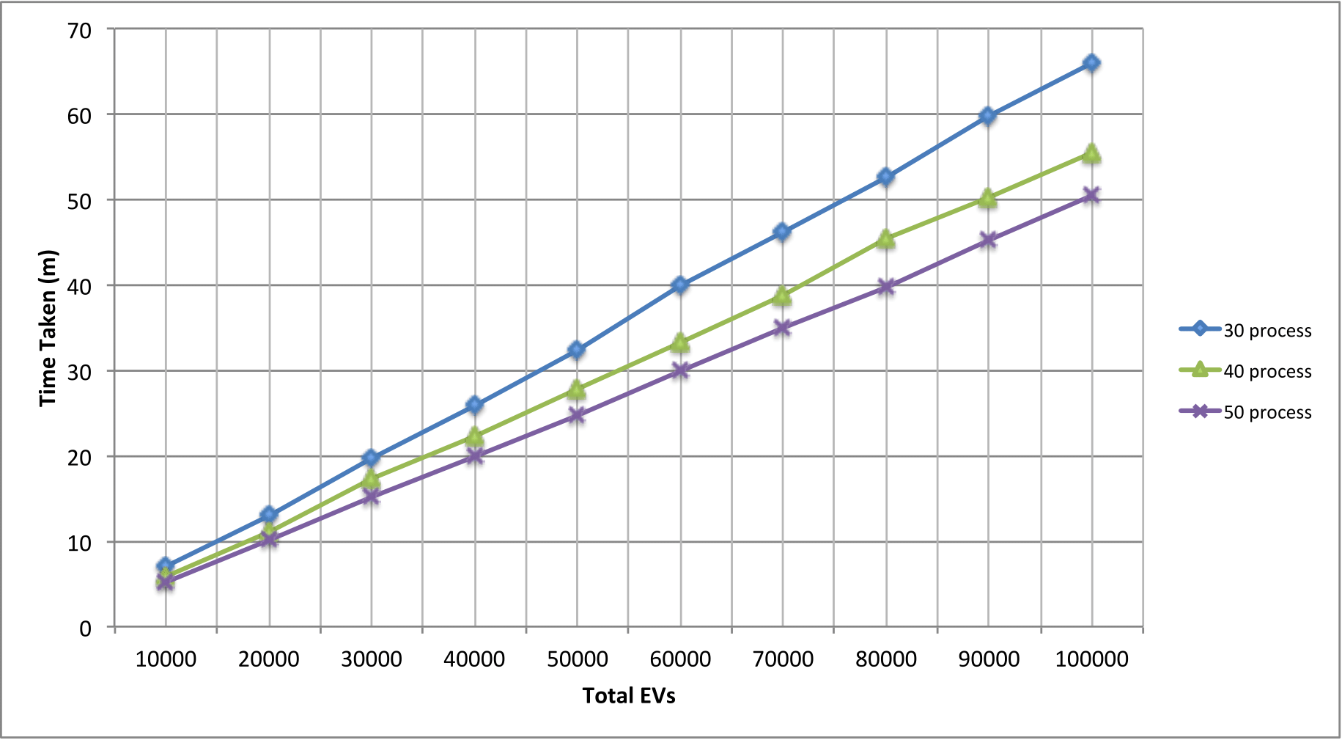

Slide 83
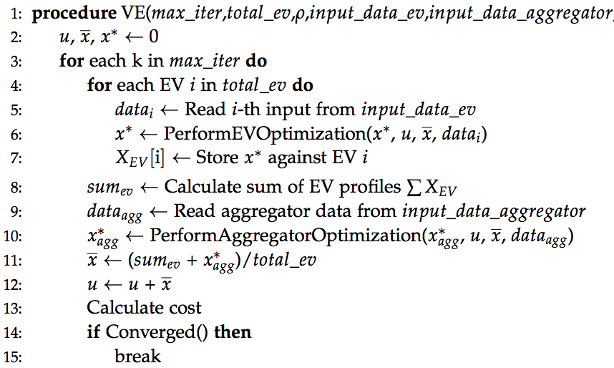
Algorithm

Slide 84
Algorithm
Notes:
Expain about slave optimization/master optimization

Slide 85
Algorithm
Runs in Parallel on Slaves
Notes:
1- Inner for loop is executed on multiple Slaves 1…N
2- Only 1 master and everything else is computed on it.

Slide 86
LRZ
Leibnitz Rechen Zentrum
Infrastructure as a Service
flexible, secure, highly available
All Docker problems gone !

Slide 87
Deployment

Slide 88
Algorithm
Runs in Parallel on Slaves
Notes:
1- Inner for loop is executed on multiple Slaves 1…N
2- Only 1 master and everything else is computed on it.

Slide 89
Algorithm

Slide 90
Abstraction on distributed system
Disclaimer: This is an alpha version.

